Slide 1
Realtime
Chat Application
Prepared by Adityan Verma
Delhi Technical Campus, Greater Noida

Slide 2
SECTION – 1
Introduction

Slide 3
Overview of the project
This project focuses on crafting a Real-time Chat Application tailored for project-based learning at our college. This innovative platform aims to revolutionize collaboration among students and instructors, fostering seamless real-time communication, resource sharing, and teamwork. By creating an environment that encourages active engagement and practical application of knowledge, our goal is to elevate the learning experience, promoting effective collaboration and problem-solving within project-based activities.

Slide 4
Importance of project-based learning
Project-based learning (PBL) is a vital educational approach that bridges theory with practical application. It empowers students by immersing them in real-world projects, fostering critical thinking, collaboration, and problem-solving skills. PBL engages learners in meaningful tasks, igniting motivation and deep understanding while preparing them for the challenges of the future job market through active participation and interdisciplinary connections.

Slide 5
Purpose of the project
The Real-time Chat Application is purpose-built to elevate project-based learning within our college by serving as a robust communication hub. Tailored for seamless interaction, file sharing, and group discussions, this platform facilitates efficient collaboration among students, instructors, and project teams. Its focal objective is to cultivate a cohesive environment that enhances teamwork, encourages idea exchange, and optimizes coordination, thereby refining the overall learning experience within projects.

Slide 6
SECTION – ii
Project Goals

Slide 7
objectives of the Real-time Chat Application
Enable swift, real-time communication among project teams, instructors, and students.
Foster seamless collaboration through file sharing and group discussions.
Enhance project coordination by aiding in task management and scheduling.
Facilitate easy access to project-related resources and materials.
Ensure a user-friendly interface for efficient utilization.
Guarantee platform security and reliability.
Implement a feedback mechanism for continuous improvement.

Slide 8
How it supports project-based learning
The Real-time Chat Application supports project-based learning by:
Facilitating Collaboration
Enhancing Communication
Enabling Resource Sharing
Streamlining Project Management
Encouraging Active Participation
Fostering a Supportive Environment
By catering to these aspects, the application becomes an integral tool that complements and augments the overall project-based learning experience, facilitating efficient collaboration, communication, and knowledge exchange among participants.

Slide 9
SECTION – iiI
Technical Specifications

Slide 10
Technical requirements for
Real-time Chat Application
Real-time Messaging: Implementing a robust messaging system that ensures instant communication among users.
User Authentication: Secure login and authentication mechanisms to protect user data.
Group Chat Functionality: Ability to create, join, and manage group conversations.
File Sharing: Support for sharing various file types among users or groups.
Scalability: Ability to handle increasing user loads without compromising performance.
Cross-Platform Compatibility: Compatibility across different devices and operating systems.
Security Measures: Encryption protocols and secure data storage to protect user information.
User-Friendly Interface: Intuitive design for easy navigation and usage.
Notification System: Alerts for new messages, updates, or mentions.
Feedback and Support: Mechanisms for user feedback and responsive support channels.

Slide 11
Tools, languages, frameworks
Frontend: Leveraging React for a dynamic and responsive user interface.
Styling: Employing Tailwind for streamlined and customizable UI design.
Backend Services: Utilizing Firebase as a Backend-as-a-Service solution for authentication and real-time capabilities.
Server-side Logic: Employing Node.js with Express to manage the server-side operations efficiently.
Database: Implementing MongoDB to efficiently handle and store chat data using two distinct models – ‘chatRoom’ and ‘chatMessage’.
Real-time Communication: Harnessing Socket.io to enable instant messaging and real-time updates within the chat application.
Network Analysis: Integrating Wireshark for in-depth network analysis, ensuring robust security and performance by monitoring and analysing network traffic.

Slide 12
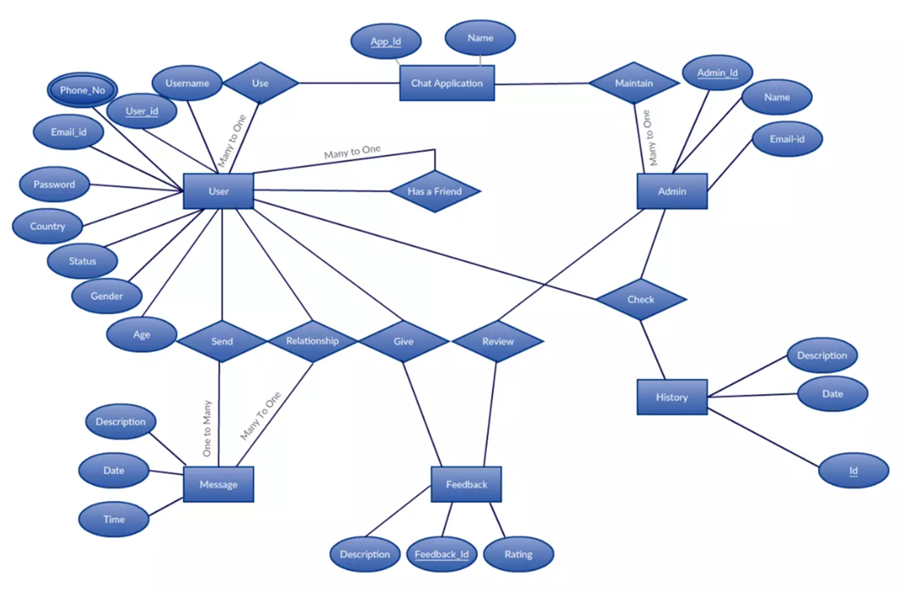
ER diagram for real-time chat application

Slide 13
SECTION – iV
FEATURES

Slide 14
List of features for
Real-time Chat Application
Real-time Messaging: Instant messaging functionality for seamless communication.
User Authentication: Secure login and authentication mechanisms for user privacy.
Group Chat Functionality: Capability to create, join, and manage group conversations.
File Sharing: Ability to share various file types among users or groups.
Responsive UI/UX: Intuitive and user-friendly interface design for easy navigation.
Customizable Themes: Tailwind integration for customizable and visually appealing themes.
Presence Indicators: Display online/offline status and indicators for active users.
Notification System: Push notifications or alerts for new messages and updates.
Search Functionality: Search feature to find specific messages or users within chats.
Message Editing and Deletion: Allow users to edit or delete sent messages if needed.
Emoji and Reactions: Support for emoji's and reactions to enhance communication.
Analytics Dashboard: Backend analytics to monitor chat usage and trends.

Slide 15
SECTION – V prototype

Slide 16
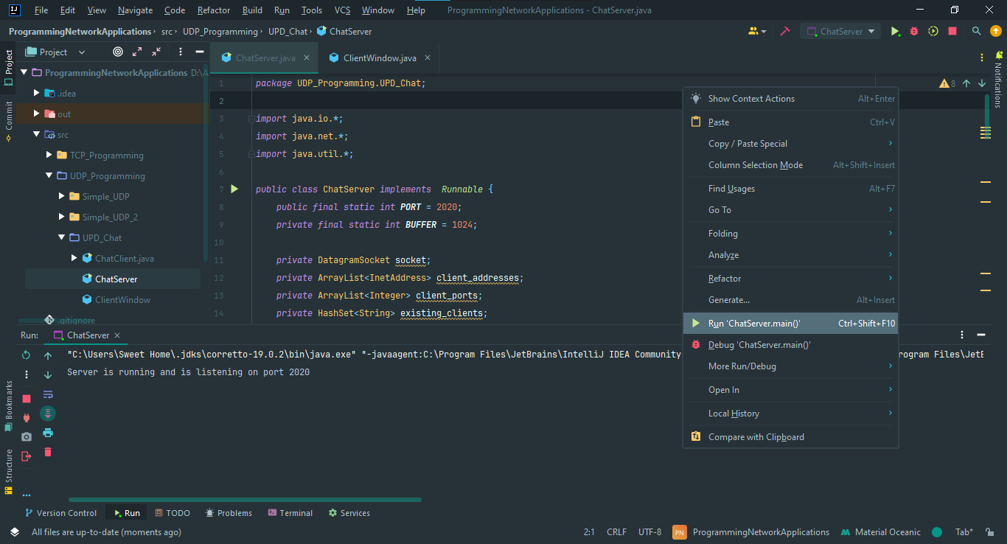

Slide 17
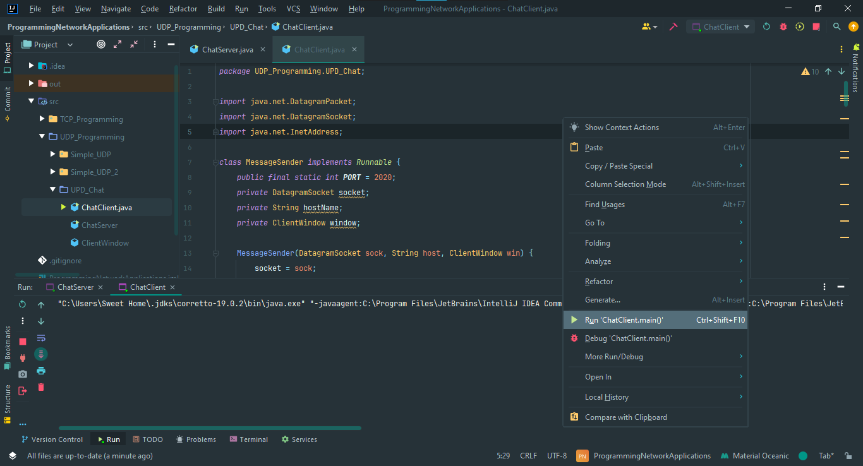

Slide 18
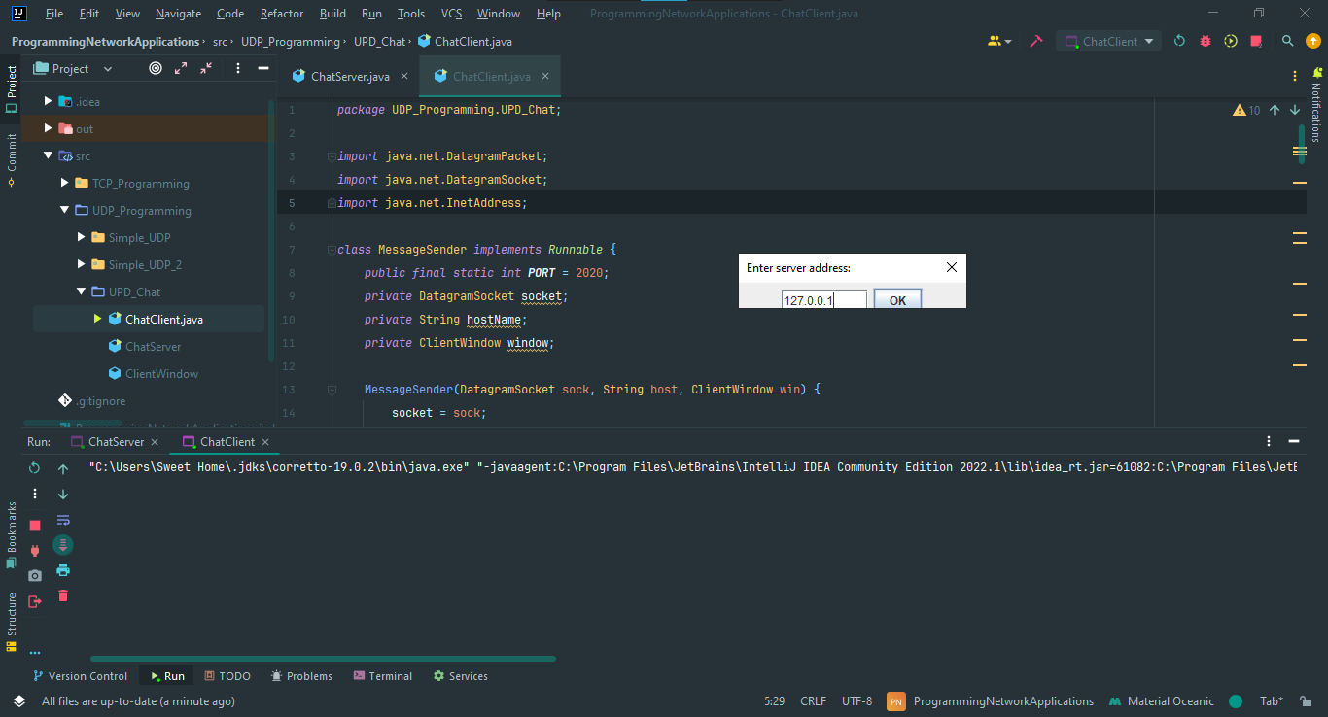

Slide 19
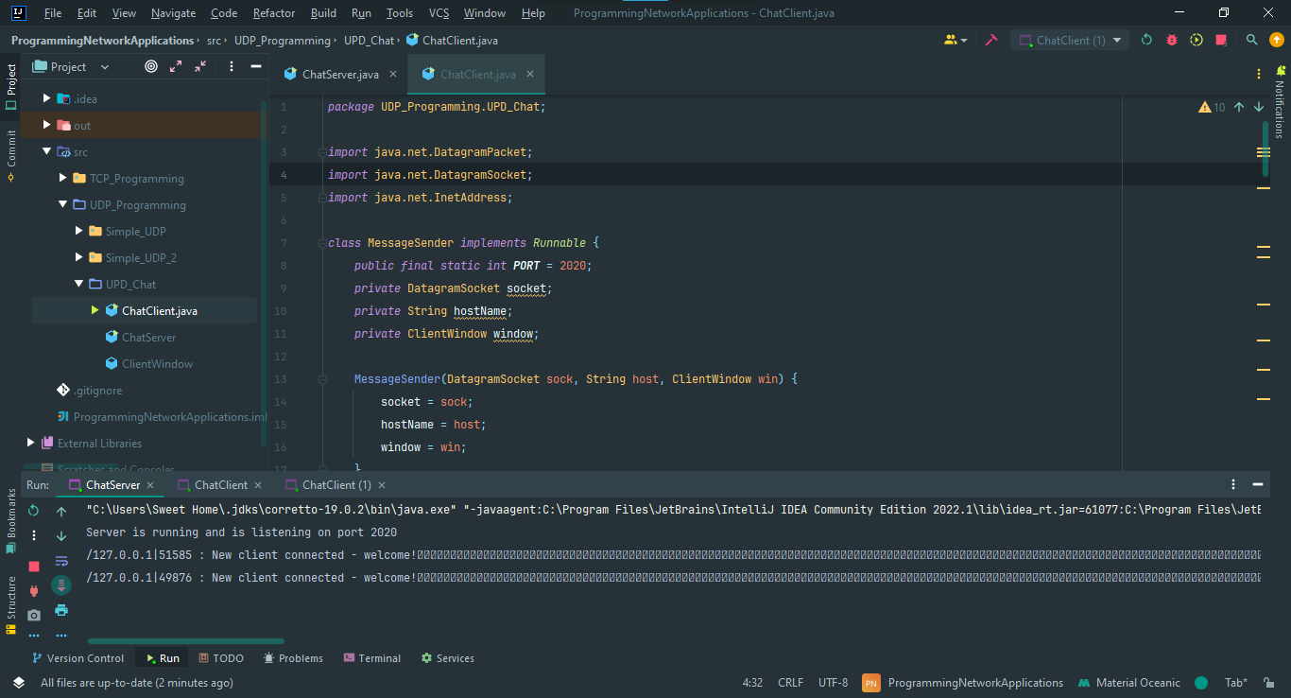

Slide 20
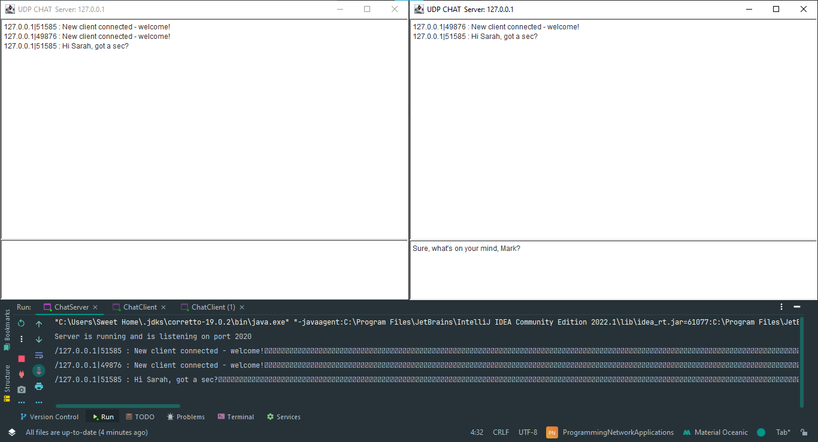

Slide 21
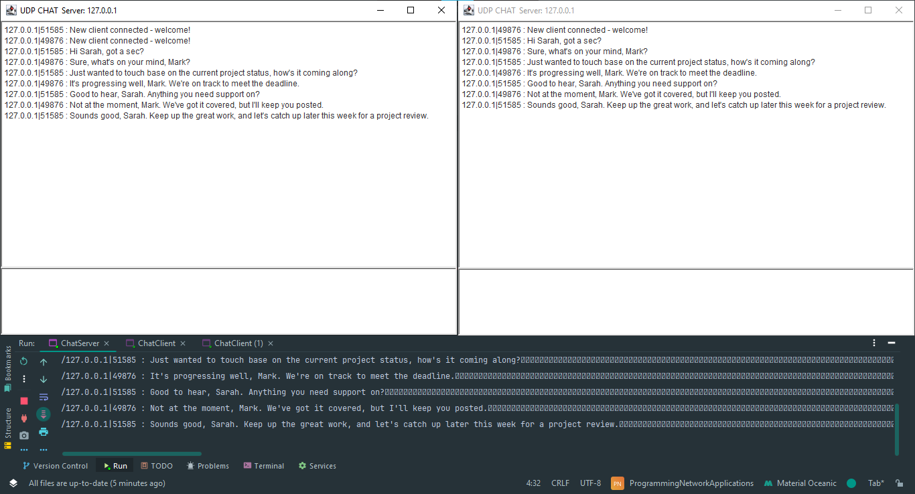

Slide 22
Summary of project
Real - time Chat Application
Key Objectives: Seamless communication, collaboration, and resource sharing.
Tech Stack: React, Tailwind, Firebase, Node/Express, MongoDB, Socket.io, Wireshark.

Slide 23
Thank you!
Grateful for your time and active participation

